Slide 1
PUBMET2025. The 12th Conference on Scholarly Communication in the Context of Open Science
Zagreb, Croatia, September 11–12, 2025
Blind spots in scholarly infrastructure:
rethinking the role of university journals
Dr. Maryna Nazarovets
Open Science Lab, TIB – Leibniz Information Centre for Science and Technology
Hanover, Germany

Slide 2
What do we mean by “university journals” (UJs)?
Umbrella term: journals published by higher education institutions
Organizational models vary:
  university presses
  university library publishing
  faculties, departments, research centers, labs etc.
  collaborations with societies or commercial publishers
  …
Strongly shaped by cultural, political, and institutional contexts

Slide 3
Why university journals?
Universities have a long tradition of publishing journals, yet their role is still underexplored
Often operate on a non-profit, mission-driven basis, supporting disciplinary and regional communities
Many provide Diamond OA pathways, enabling no-cost access for authors and readers
Contribute to bibliodiversity and knowledge equity, especially in underrepresented regions
🔶 But: they face challenges of visibility, sustainability, and recognition in global scholarly infrastructures

Slide 4

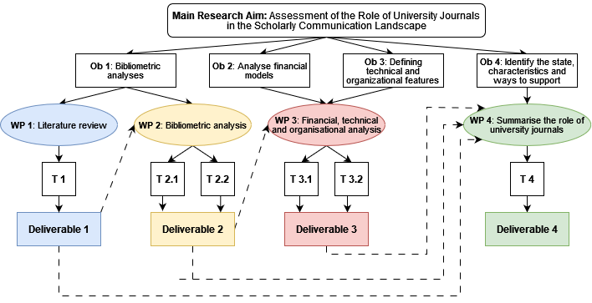
‘The role of university journals in scholarly communication in an academic publisher oligopoly environment’
funded by DFG, project number 541976107
How many UJs exist globally?
Where and how are they indexed?
What are the structural barriers to visibility, legitimacy, and sustainability?
How can UJs be better integrated into scholarly communication policies?

Slide 5
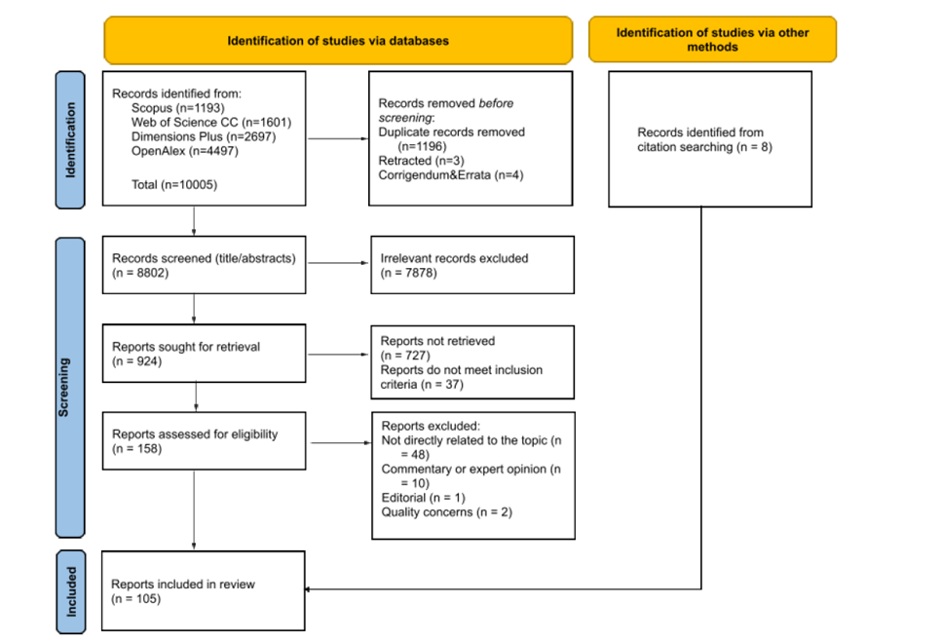
What do we already know?
A semi-systematic literature review (105 items)
No formal definition of UJ; UJs treated as a distinct category across varied typologies
Visibility & indexing: limited international reach due to language, selective indexing, and non-standardised metadata
Governance & peer review: uneven professionalisation; issues incl. endogamy/opacity; need for training and clearer standards
Technical infrastructure: digital transition & platform upkeep strain small teams; consortia help close capacity gaps
Sustainability & resources: volunteer labour; inconsistent institutional/government support
Nazarovets, M. (2025). University journals: A semi-systematic literature review of trends, challenges, and future research directions. Insights, 38, 13. https://doi.org/10.1629/uksg.705

Slide 6
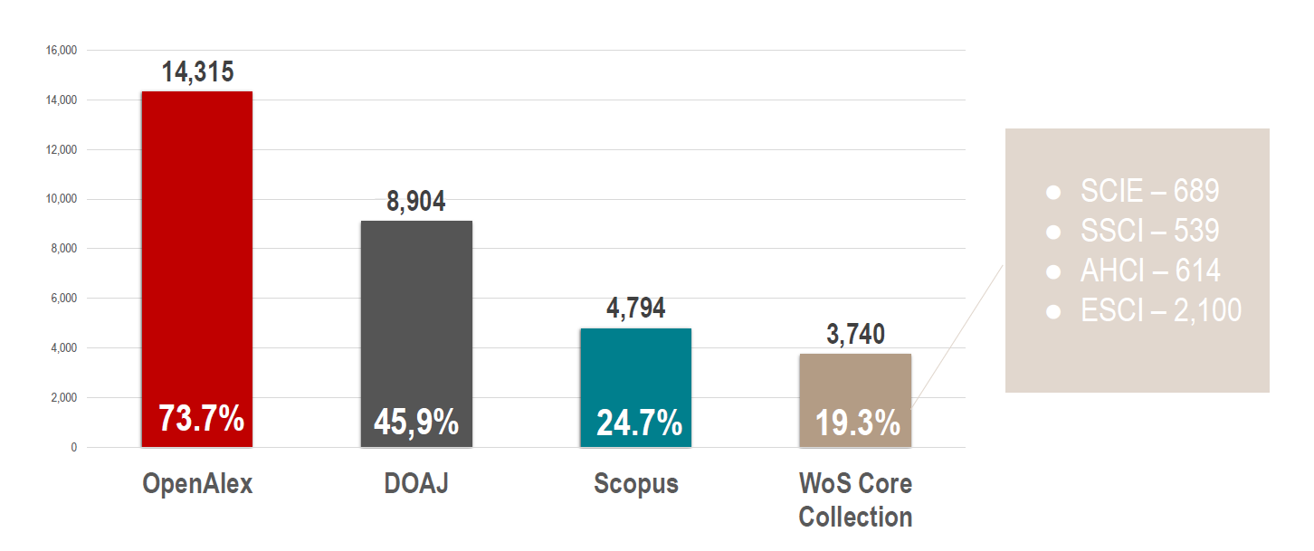
How did we map the UJs landscape?
Ulrichsweb snapshot of active, peer-reviewed titles; identify UJs by current HEI publisher
Curate a global list of UJs (deduplication; targeted manual checks) → 19,414 titles in 148 countries
Check index presence (OpenAlex, DOAJ, Scopus, WoS CC) via ISSN/eISSN/ISSN-L matching to measure coverage
🔶 Data limits (Ulrichsweb “Refereed / Peer-reviewed” tag; publisher fields in OpenAlex; snapshot timing)
Nazarovets, M., Laakso, M., & Taskin, Z. (n.d.). University journals in the global academic publishing landscape: Mapping over 19,000 diverse titles. Retrieved from https://osf.io/preprints/socarxiv/q6fpw_v1

Slide 7
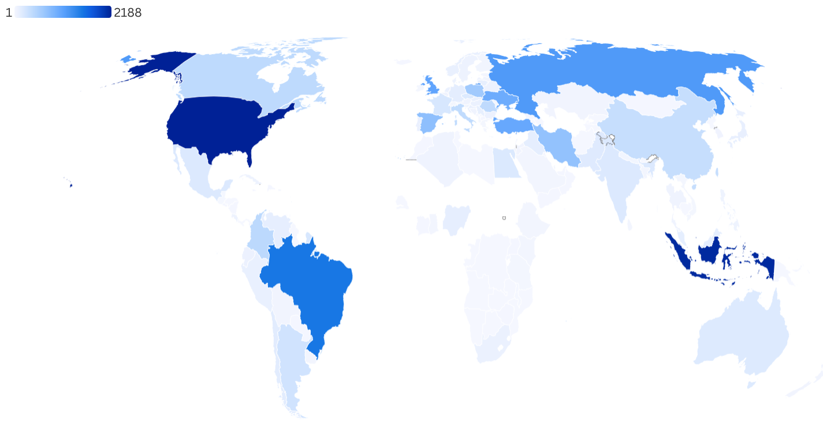
Where are university journals?
By World Bank regions: Europe & Central Asia – 43.7%, East Asia & Pacific – 16.1%, Latin America & Caribbean – 16.1%, North America – 13.4%, Middle East and North Africa – 6.7%, South Asia – 2.3%, and Sub-Saharan Africa – 1.8%
Country counts are highly uneven: the United States (2,188), Indonesia (2,131), and Brazil (1,530) lead, while 16 countries have only one title each.
Within-region asymmetries are pronounced: Indonesia ≈68% of East Asia & Pacific; Brazil ≈50% of Latin America & Caribbean; Iran 56% of Middle East and North Africa

Slide 8
What are the key takeaways?
Regions & income: Scopus/WoS only cover a fraction and over-select high-income countries; OpenAlex/DOAJ show broader inclusion across middle-income regions – this reproduces regional and income asymmetries in what “counts”
English acts as a gatekeeper: most UJs are not English-only, yet selective indexes reward English (or at least “multilingual with English”) and penalize national-language and multilingual-without-English journals
The UJ landscape is SSH-centred (~60%) across platforms; multidisciplinary ≈ 13-14%; STEM fields smaller shares
Open access: Global OA status cannot be measured comprehensively (Ulrichsweb flags incomplete; DOAJ is selective)
  🔶 But DOAJ evidence indicates substantial OA/Diamond presence among UJs

Slide 9
What’s next? Editorial governance & integrity
Moving to comparative case analyses of editorial practices, peer-review standards, technical capacity, and international engagement.
  Editorial endogamy – over-representation of host-institution scholars on UJ editorial boards
  It threatens peer-review integrity, credibility, and international visibility
  Cross-national pattern:
    Spain – entrenched internal hierarchies hinder internationalization
    Turkey – insider authors favored, faster acceptance of local submissions
    China – strong institutional control, guanxi networks shape decisions
  Despite regional differences, editorial endogamy emerges as a systemic challenge across diverse academic contexts
  Nazarovets, M., & Nazarovets, S. (2025). Prevention of endogamy in the editorial boards of university journals. Journal of Academic Ethics. In Press.

Slide 10
Closing thoughts
University journals are non-commercial, diverse and deeply rooted in long-standing traditions. They are a vital but often overlooked part of scholarly publishing
They also face serious challenges: fragile funding, weak infrastructures, limited visibility and indexing, and editorial issues
Rather than standardisation, the way forward is to remove systemic barriers while addressing these internal weaknesses
Recognition on their own terms – through locally appropriate support, capacity-building, and inclusive infrastructures – is essential for their sustainability
Taking a closer look at their experience can help shape a more equitable and diverse future for scholarly communication

Slide 11
Dr. Maryna Nazarovets
TIB – Leibniz Information Centre for Science and Technology, Open Science Lab, Hanover, Germany
https://orcid.org/0000-0003-1797-4533
maryna.nazarovets@tib.eu

