Slide 1
Repository related challenges in supporting Secondary Publication Rights and Rights Retention
Ana Lazarova
Sofia University “St. Kliment Ohridski”, Digital Republic Association
Eric Luth
Wikimedia Sverige
Iva Melinščak Zlodi
University of Zagreb, Faculty of Humanities and Social Sciences Library

Slide 2
Pragmatics of Implementing Secondary Publication Right (SPR), Secondary Publication Obligation (SPO) and Right Retention (RR)
Once these are in place, implementation is needed in order to:
Monitor compliance – practical perspective
Showcase the impact – policy perspective
Ensure adherence to legal terms – legal perspective
Facilitate clear understanding and (re)use – user perspective

Slide 3
Key infrastructure for SPR&RR: open repositories
self-archiving & “green route” to open access
quality metadata and interoperability standards (OAI-PMH)
institutional repositories and their networks
national and international access points and aggregators
importance of metadata on
access and reuse rights
copyright ownership
mode of delivering the right to (re)use

Slide 4
Metadata on rights and licences need to be:
standardised (use controlled vocabularies)
available in machine-readable form (URIs) for exchange with other information systems
clearly displayed on the record website (through the logo and a hyperlink)

Slide 5
Adopted standard for repositories: OpenAIRE Guidelines
OpenAIRE Guidelines for Literature Repository Managers describes two properties that need to be described:
Access Rights (Mandatory) Datacite:rights COAR Access Right Vocabulary
License Condition (Recommended) oaire:licenseCondition

Slide 6
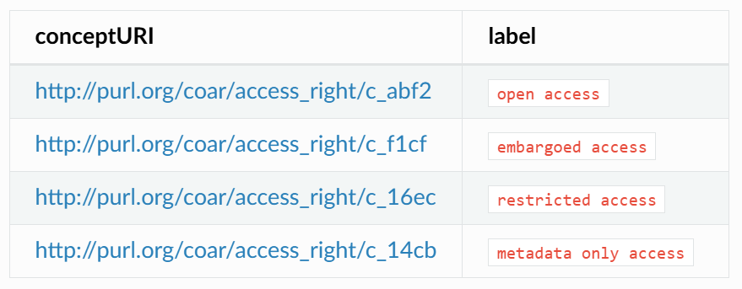
Access rights
Definition: Open access refers to a resource that is immediately and permanently online, and free for all on the Web, without financial and technical barriers.The resource is either stored in the repository or referenced to an external journal or trustworthy archive.

Slide 7
License Condition (R)
Information about license rights held in and over the resource.
Usage Instruction
Typically, a rights element will contain a rights management statement for the access or use of the object, or reference a service providing such information. Rights information often encompasses Intellectual Property Rights (IPR), Copyright, and various Property Rights. It is preferred to refer to a rights service where the reuse rights are made clear to the end-user by using a URL. For example the Creative Commons organisation has created URIs for their different licences in the different jurisdictions. This can be applied to create machine readable usage licenses.

Slide 8
Challenges in implementation

Slide 9
In repositories
Some repositories are not OpenAIRE compliant
Some repositories have recorded access rights and licence conditions but don’t display them on the landing pages
Often, only access rights are recorded, but not licence conditions
Often, no filter/browse options on these criteria
Even if both rights and licences are there, we don’t know:
Who is the copyright owner (relevant when some rights are reserved)
What is the legal ground of open access (publishing in OA, RR, SPR, OoC…)

Slide 10
At aggregators and discovery services
Importance of national aggregators (e.g. DiVA, BPOS, Open Science Slovenia, RECOLECTA…) and international discovery services (OpenAIRE Explore, OpenAlex…)
In some of them the metadata on access rights and licence conditions is not properly collected and displayed
browse/filter options based on these criteria are often lacking

Slide 11
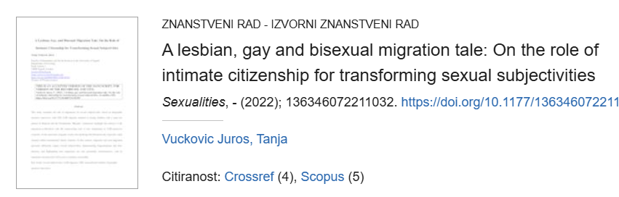
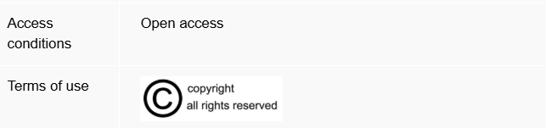
Example: DABAR repository

Slide 12
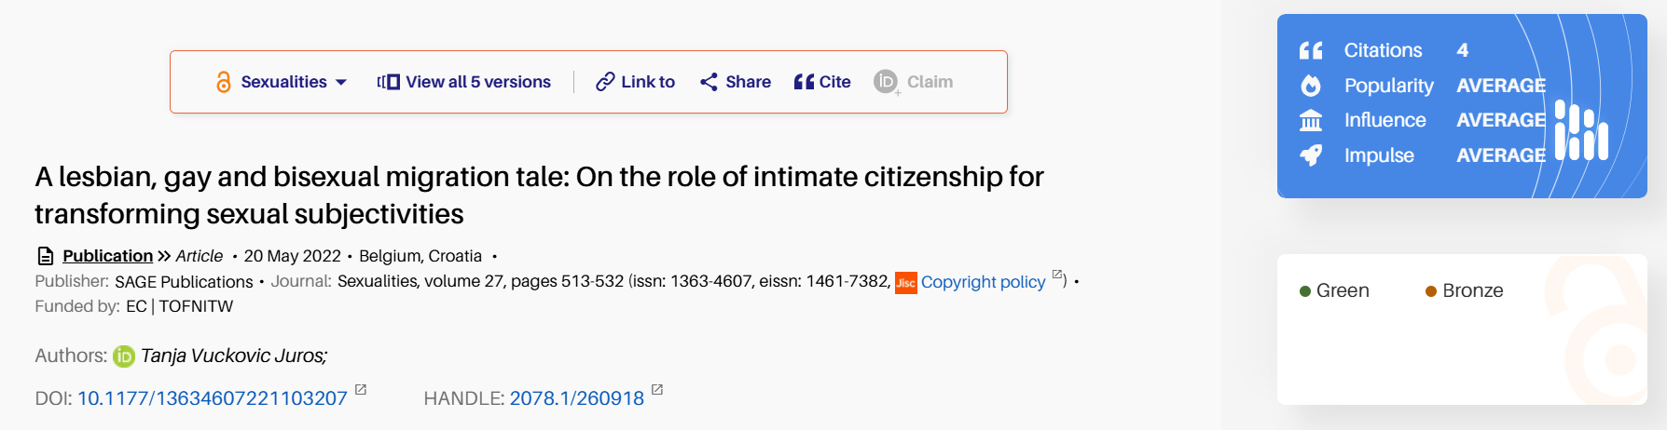
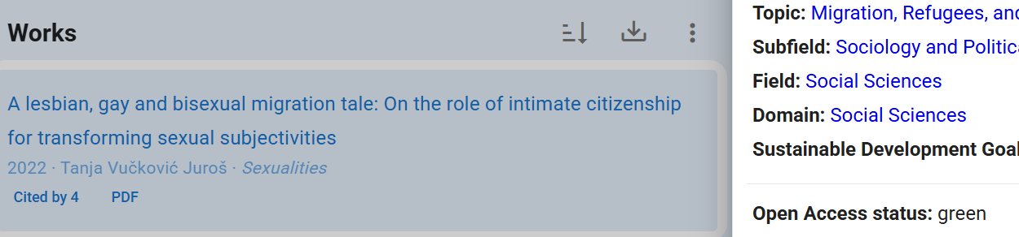
Aggregators: OpenAIRE Explore & OpenAlex

Slide 13
For KR21 future work

Slide 14
Problems to be solved
in terms of their metadata quality, are repositories across Europe adequately equipped to support the implementation of newly emerging rights?
this is not always the case: some institutional and national repositories lack standardised fields for recording and displaying licensing or copyright metadata, while others use these fields inconsistently or fail to present this information clearly
where such repository capacity is absent or inconsistently applied, the adoption of RR policies or exercising SPR may be delayed or fragmented

Slide 15
KR21 plans for further research
mapping project: how national repository networks and aggregators handle metadata related to copyright status and ownership, and licences for reuse
carried out through the Knowledge Rights 21 network of National Contacts
exploring gaps, variations, and promising practices in metadata implementation
opening a discussion on the potential use of rightsstatements.org

Slide 16
Use of Rights Statements

Slide 17


Slide 18

some
rights reserved

Slide 19










}
Attribution
Признание
Noncommercial
Некомерсиално
ShareAlike
Споделяне на споделеното
NoDerivs
Без производни версии

Slide 20


Public
Domain Dedication
Public Domain
Mark

Slide 21



Slide 22
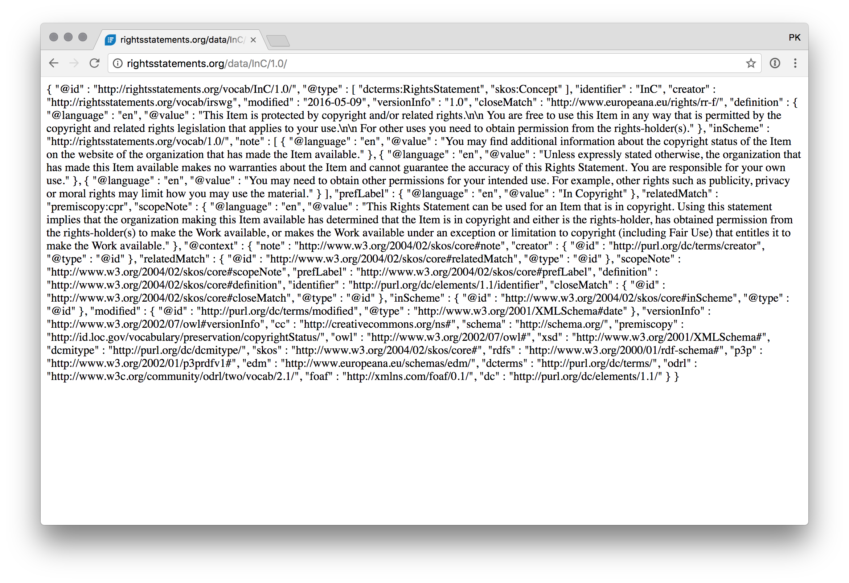
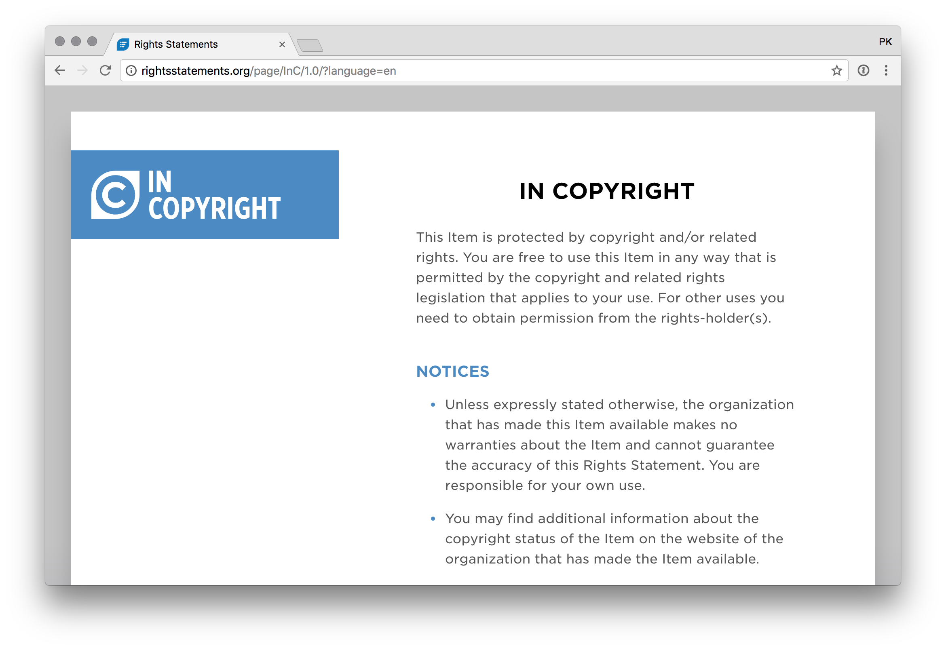
http://rightsstatements.org/vocab/InC/1.0/
RDFa
HTML

Slide 23



Три категории означения
In Copyright
No Copyright
Copyright Status Unclear

Slide 24





In Copyright Statements
This statement indicates that the work marked with it is subject to copyright
This statement indicates that the work marked with it has been identified as an orphan work under the conditions of the European directive.
This statement indicates that the work marked with it is subject to copyright, but the rightsholder is either unknown or cannot be located.
This statement indicates that the work marked with it is subject to copyright, but its use for educational purposes is permitted without additional permission.
This statement indicates that the work marked with it is subject to copyright, but its use for non-commercial purposes is permitted without additional permission.

Slide 25




Out-of-Copyright Statements
This statement indicates that the work marked with it is in the public domain, but the organization that published it has contractually allowed its use only for non-commercial purposes.
This statement indicates that the work marked with it is in the public domain, but there are other types of usage restrictions.
This statement indicates that the work marked with it is in the public domain, but the organization that published it has contractually imposed usage restrictions.
This statement indicates that the work marked with it is in the public domain in the United States, but its copyright status has not been assessed in other countries.

Slide 26



Other Rights Statements
This designation indicates that the data provider has not examined the copyright status of the work.
This designation indicates that the data provider has examined the copyright status of the work but was unable to determine it.
This designation indicates that the data provider believes that the work is free of copyright and related rights, but this has not been confirmed with certainty.

Slide 27
Implementation of RS.org by Academic Libraries
This statement indicates that the work marked with it has been identified as an orphan work under the conditions of the European directive.
In Copyright - OOCW
The work is in Copyright, but available under the Out-of-Commerce-Works regime.
In Copyright - SPR
The work is in Copyright, but is made available under Open Access under a legal SPR provision.

Slide 28
References
Commission: Directorate-General for Research and Innovation. (2022). European Research Area policy agenda: overview of actions for the period 2022-2024. Publications Office of the European Union. https://data.europa.eu/doi/10.2777/52110
Labastida i Juan, I., Melinščak Zlodi, I., Proudman, V. & Treadway, J. (2023). Opening Knowledge: Retaining Rights and Open Licensing in Europe. Zenodo. https://doi.org/10.5281/zenodo.8084051
Lazarova, A. (2024). Conceptualising the Right to Secondary Publication. In C. Sganga & T. E. Synodinou (Eds), Flexibilities in Copyright Law, Routledge, Forthcoming, Available at SSRN: https://ssrn.com/abstract=4934531
Treadway, J., Labastida, I., Melinščak Zlodi, I., & Proudman, V. (2025). Building bridges to Open Access. Paths to Institutional Rights Retention in Europe 2024 (Version v1). Zenodo. https://doi.org/10.5281/zenodo.15078315
UNESCO Recommendation on Open Science. (2021). https://doi.org/10.54677/MNMH8546

Slide 29
Thank you!

