Slide 1


On open practices and quality standards of research data in Dataverse UNIMI (with a focus on SSH disciplines)
PUBMET2025! The 12th Conference on Scholarly Communication in the Context of Open Science, September 11-12, 2025
Carolina Manfredini, Laura Giovinazzi, Margherita Criveller
Università degli Studi di Milano

Slide 2


Dealing with data in the Social Sciences and Humanities
«I am a researcher in the humanities, open and fair data does not concern me»
«I am a researcher in the humanities, I don't deal with data, so why should I be interested in its quality?»
What do we mean by "data"?
When data is a dirty word
UNIMI is strongly committed to advancing open data practices across all academic disciplines and to fostering high standards of data quality
Research data management policy
Milano University Press, the diamond open-access publishing house
Repository for scientific publications (AIR/IRIS)
Repository for FAIR research data (Dataverse UNIMI)

Slide 3
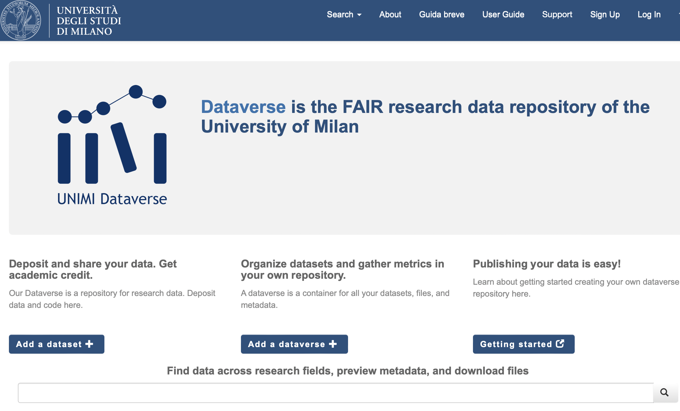

UNIMI’s institutional repository for research data
Open source software
Developed in 2006 by the Institute for Quantitative Social Science of the Harvard University
More than 100 installations in 6 continents
Data@UNIMI was adopted in 2018 and obtained the CoreTrustSeal in October 2024

Slide 4

SSH data on Dataverse UNIMI
FILMUSP – Music publishing and films
VIOLENDINGS
ITACA
LiMe - Liber sententiarum potestatis Mediolani
CRAFTWORK
IPAD – Italian Performative Archive in Digital
TIMELAPSE
and many more still ongoing: Ancient near east, Russian spoken corpus, Death Registers of Milan…

Slide 5
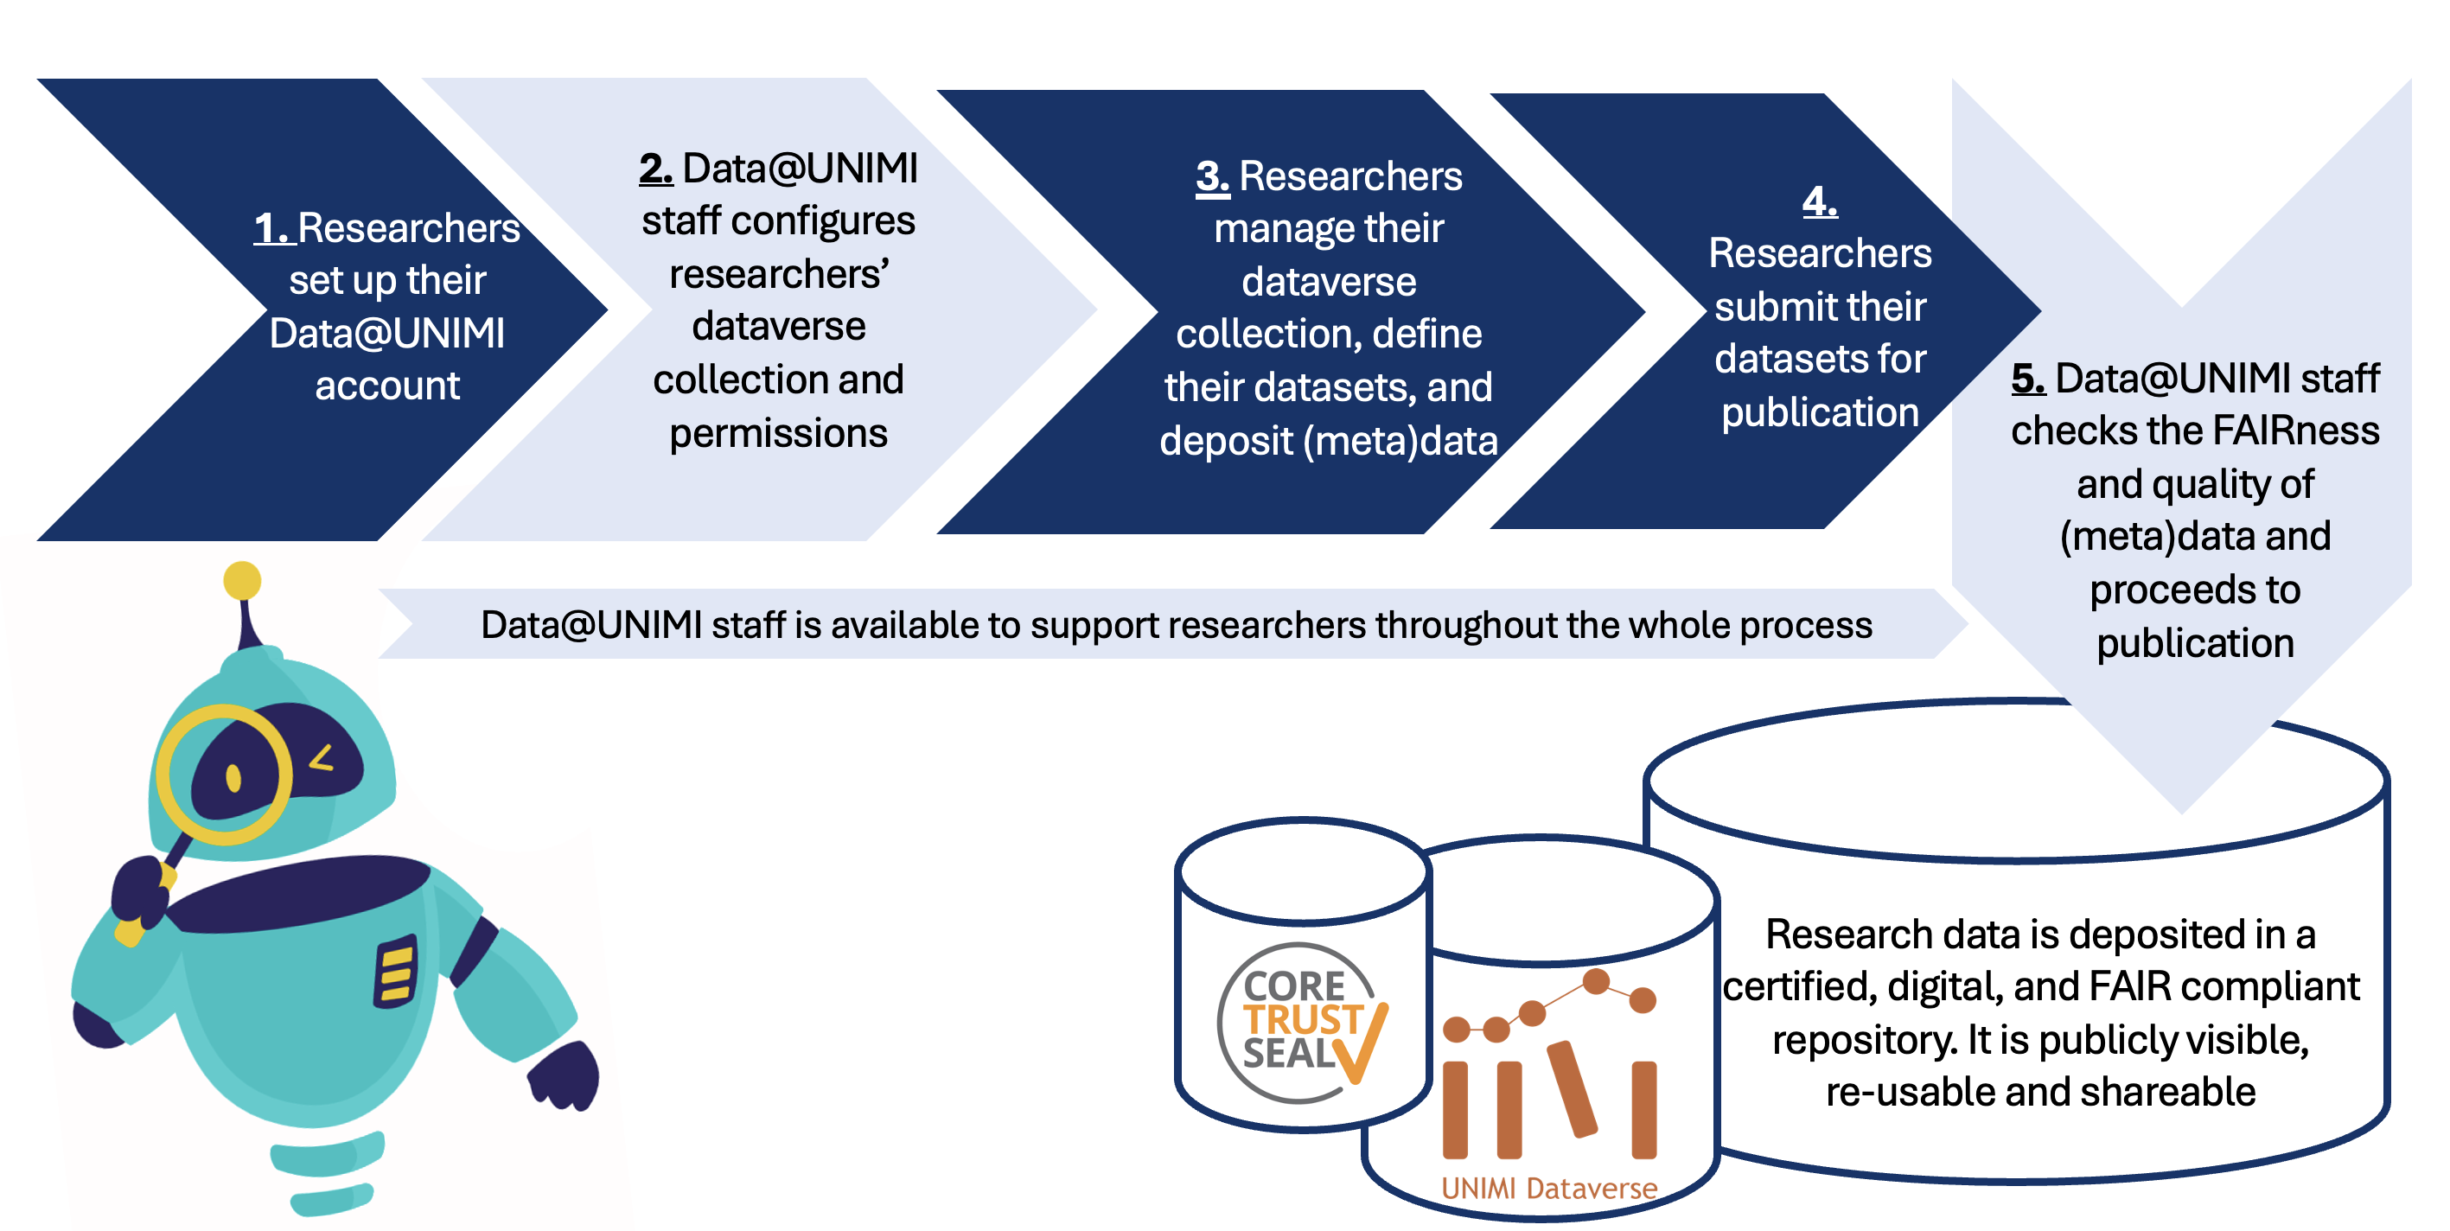
Data@UNIMI’s (renewed) workflow

Slide 6
Efforts towards open sharing and quality managing of data
Data and metadata are validated prior to publication through a quality control framework that integrates automated tools (draft check, completeness check, admin check) alongside verification performed by data stewards, checking for:
Naming and structure
Type of format
Type of license and terms
Presence of a README file
Level of completeness of metadata and indication of standards used
Compliance with legal and ethical issues
Publication status

Slide 7
Promoting a culture of open and high‑quality data…
The renewed system enables a more targeted and meaningful dialogue with researchers, ultimately benefiting the entire academic community: this development is part of UNIMI’s ongoing commitment to fostering a culture of research grounded in reproducibility and validation of research, quality and integrity of data, transparency of processes and open access to the results of science
Renewal of the RDM website (soon to be bilingual)
Drafting of new thematic guidelines
Update of the online trainings, also with advanced courses
Opening of an online appointment calendar for virtual consultations
Publishing of a RDM checklist

Slide 8

…and especially in the SSH
Enhance the association between the published data and its related publication (also via AIR), connecting the variety of Open Science practices and tools of the University
A new page in the website dedicated to RDM in the SSH
New practical and discipline-specific workshops – one especially dedicated to SSH
Specific events, such as the seminar held for the Department of Cultural Heritage and the project on DMPs for PhD students (see testimony here)
Survey on RDM practices amongst SSH researchers (soon to be launched)
Dataverse trainings dedicated to authors and editors of the Milano University Press, both books and journals (mainly from SSH), to achieve that all articles that use data deposit it in Dataverse

Slide 9
Thank you for your attention
Carolina Manfredini, Laura Giovinazzi, Margherita Criveller
rdm@unimi.it | dataverse@unimi.it

