Slide 1

Barriers and Enablers for Open Science in Slovenian Copyright Law
Dr. Maja Bogataj Jančič, LL.M. (Harvard), LL.M. (Torino) (KR21 NC, KR21 RC)
Open Data and Intellectual Property Institute ODIPI
11. 9. 2025, PUBMET 2025, Zagreb

Slide 2
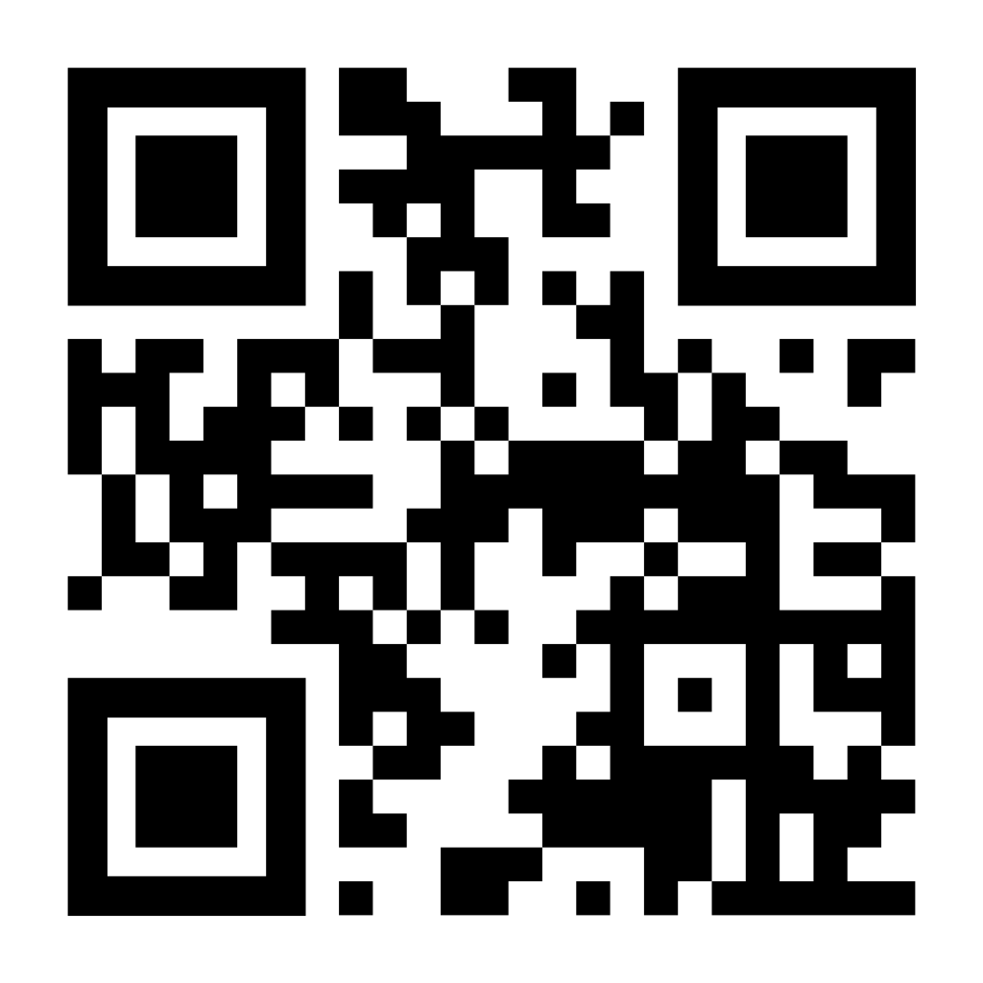
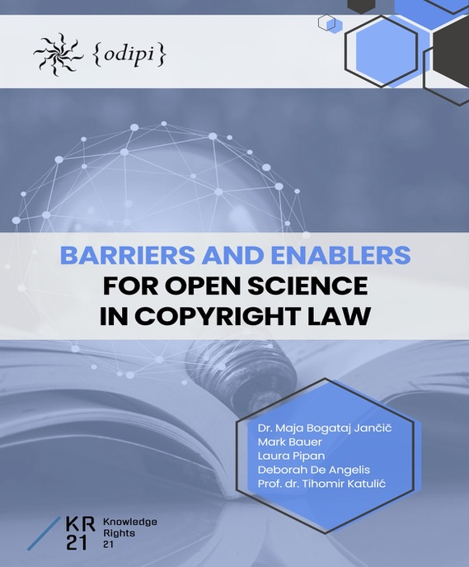
The Study
ODIPI with the support of the KR21 conducted a study on barriers and enablers for open science in copyright law, within the framework of which it analysed the copyright legislation of three countries (Slovenia, Italy and Croatia).
ODIPI also prepared a questionnaire to analyse other jurisdictions.

Slide 3
The Objectives of the Study
The study aimed to:
identify which provisions in national copyright laws act as barriers to Open Science, hindering progress and access;
determine which copyright provisions may serve as enablers, facilitating Open Science initiatives.
What was done?
ODIPI prepared a questionnaire to assess copyright legislations in other European countries;
researchers analysed copyright laws in Slovenia, Italy and Croatia guided by a comprehensive questionnaire developed by ODIPI.

Slide 4
Slovenian Legal Framework
Copyright and Related Rights Act (Slo. Zakon o avtorski in sorodnih pravicah – ZASP);
Scientific Research and Innovation Activities Act (Slo. Zakon o znanstvenoraziskovalni in inovacijski dejavnosti – ZZrID);
Decree on the Implementation of Scientific Research in Accordance with the Principles of Open Science (Slo. Uredba o izvajanju znanstvenoraziskovalnega dela v skladu z načeli odprte znanosti – Decree on Open Science).

Slide 5
What are barriers and enablers in this context?
Barriers: multitude of reasons hindering the uptake of Open Access to and reuse of research/results, such as lack of time or resources, constraints imposed by the policies of scholarly journals and other publishers, perceived lack of benefits, the absence of funder or employer requirements, and concerns regarding copyright or licensing provisions;
Enablers: range of measures, policies and strategies designed to encourage the uptake of Open Access to and reuse of research/results. Such mechanisms make it easier for researchers to share their work, promote wider dissemination, greater access and reuse to scientific knowledge.

Slide 6
Barriers
The most significant obstacles in Slovenian copyright law:
the requirement for consensual management of copyright, which mandates unanimous consent among all rights holders for the use of a work (Art. 12 and 13 of ZASP). This requirement is particularly relevant for co-authored works and compound works, where it complicates rights management, limits the accessibility of research outputs, and creates obstacles to knowledge dissemination;
the unwaivability of the right to remuneration or fair compensation (Artt. 37, 76, 104, 107, 122, 123, 124 of ZASP), as authors cannot renounce these rights even if they clearly wish to make their work openly accessible. This restriction allows collective management organisations to claim remuneration on the author’s behalf (regardless of the author’s own preferences), imposing financial and administrative burdens on repositories and other platforms committed to ensuring Open Access and facilitating the reuse of research results.

Slide 7
the requirement for specific separate transfers of rights (Art. 76 of ZASP). Copyright law often mandates that the individual components of economic rights must be transferred separately, necessitating distinct agreements for different types of uses. This fragmentation complicates rights management and discourages researchers from pursuing Open Access publication due to increased administrative complexity;
the requirement for special consent of the author for subsequent transfers (Art. 78 of ZASP) imposes additional constraints. Even if a copyright holder has transferred rights, further transfers to third parties require explicit author consent unless contractually stipulated otherwise. This requirement introduces legal uncertainty and administrative inefficiencies, further limiting the potential for broader dissemination of research results;

Slide 8
the requirements for formality (Art. 80 of ZASP) can mandate that all transfers of economic rights, as well as authorisations, be made in writing. The absence of a written agreement leads to an interpretation in favour of the author (in dubio pro auctore), creating potential ambiguities that complicate the negotiation and implementation of Open Access agreements;
the presumption of the publisher’s priority right (Art. 89 of ZASP) limits the ability of authors to publish their works through multiple channels. By granting publishers of physical works a privileged position regarding electronic publication, this presumption restricts the immediate availability of research outputs on Open Access platforms and conflicts with legislative efforts to introduce Secondary Publishing Rights (SPRs).

Slide 9
Both Barrier and Enabler
The presumption of transfer of economic rights from employees to employers (Artt. 101, 102, 112, 141e of ZASP) is such provision. When a copyright work is created in the course of employment, economic rights are often deemed to be transferred to the employer, typically for a set period. This presumption can restrict authors from managing their works under open licenses, as they transfer economic rights to employer. If an employer does not actively support Open Access policies, researchers may face barriers in making their work openly available.
This mechanism can also serve as an enabler, allowing institutions which have aligned with Open Science principles to disseminate research outputs broadly without requiring additional consent from the author. The effect of this provision is therefore contingent on the policies and commitments of the employer.

Slide 10
Enablers
Explicit enablers for Open Science within copyright law remain largely absent:
Art. 57b of ZASP, which implements Art. 3 of the DSM Directive, introduces a specific exception allowing text and data mining (TDM) for scientific research, which can act as a powerful enabler of research, science and, of course, Open Science. It grants research organisations, publicly accessible archives, libraries, museums, film or audio heritage institutions, public broadcasting organisations, and persons affiliated with these institutions the right to freely reproduce works and carry out TDM operations, provided they have lawful access to the works. The exception allows for the digitisation of analogue content and the remote access to content where necessary for the purposes of TDM;

Slide 11
Outside the Slovenian Copyright Law
ZZrID mandates Rights Retention (RR) – a crucial mechanism for ensuring that publicly funded research remains openly accessible. The concept of RR is further detailed in the Decree on Open Science. Compliance with the RR obligation functions not only as an enabler, but as an incentive for Open Science principles, reinforcing its uptake through financial conditions tied to research funding eligibility and legally prescribed sanctions for non-compliance.
Secondary Publishing Rights (SPRs) in the amended ZZrID (May 2025) provide a legal basis for enabling Open Access to and reuse of publicly funded scientific publications and research data (i.e., research co-funded by public resources to a level of at least 50%). This right may be exercised by the author/researcher (or their employer) or by the provider of scientific research activities.

Slide 12
Conclusions
Copyright laws across Slovenia, Italy and Croatia still impose significant barriers to the full realisation of Open Science goals, despite political, strategic and financial support at the EU and national levels.
The study highlights a clear disconnection between strategic commitments to Open Science and the prevailing legal realities, which create a complex, uncertain landscape for researchers and cross-border collaboration.
The rapid reform of copyright laws is essential. Study recommends aligning legal frameworks with Open Science goals by addressing structural barriers while leveraging existing mechanisms to support openness where possible.
The study was submitted as evidence in the consultation process for ERA ACT.
The study can be expanded to other jurisdictions by using ODIPI’s questionnaire. Welcome to participate!

Slide 13

For more information:
Thank you!
www.odipi.si
maja.bogataj@ipi.si

