Slide 1

Lost in publication: a journey through questionable evidence
Livia Puljak
Catholic University of Croatia

Slide 2
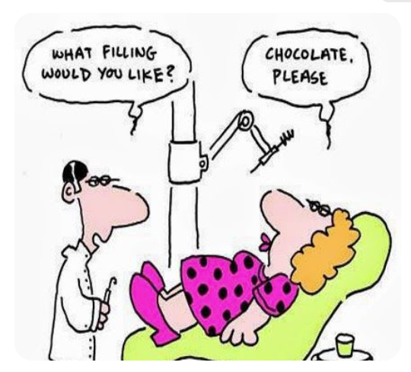
Biomedical perspective

Slide 3
Credibility of scientific research
Depends on its reproducibility, transparency, and methodological rigor
However, numerous studies across disciplines (many of which I have authored myself) have highlighted pervasive challenges in these areas:
Incomplete reporting
Outcome switching
Lack of protocol registration
Insufficient data sharing…
These issues could undermine the reliability of findings, hinder evidence synthesis, and contribute to research waste
Transparent methods should enable verification, reuse, and better use of evidence

Slide 4

I think we have documented problems well enough
When somebody suggests – let’s do another study about the completeness of reporting…

Slide 5
I would rather talk about solutions
Preregistration (registration)
Adherence to reporting guidelines
The adoption of FAIR data principles in enhancing transparency…
We have many nice ideas
These solutions sometimes create new problems

Slide 6

Zombie systematic reviews
Andrade et al. (2019): Zombie reviews taking over the PROSPERO systematic review registry. It’s time to fight back!
Zombie reviews
Systematic reviews that have been registered (e.g. in PROSPERO)
But abandoned
But not flagged as abandoned
So, other authors may think that this topic is „taken”

Slide 7
What can we do?
Education
Role modeling – teaching by example
Mandating (requesting)
On all levels of the research ecosystem
And monitoring the efficacy of solutions
Maybe AI will help people with planning and publishing better reports
We will likely not move easily from a „publish or perish” culture
But we can test interventions that will make things better

