Slide 1
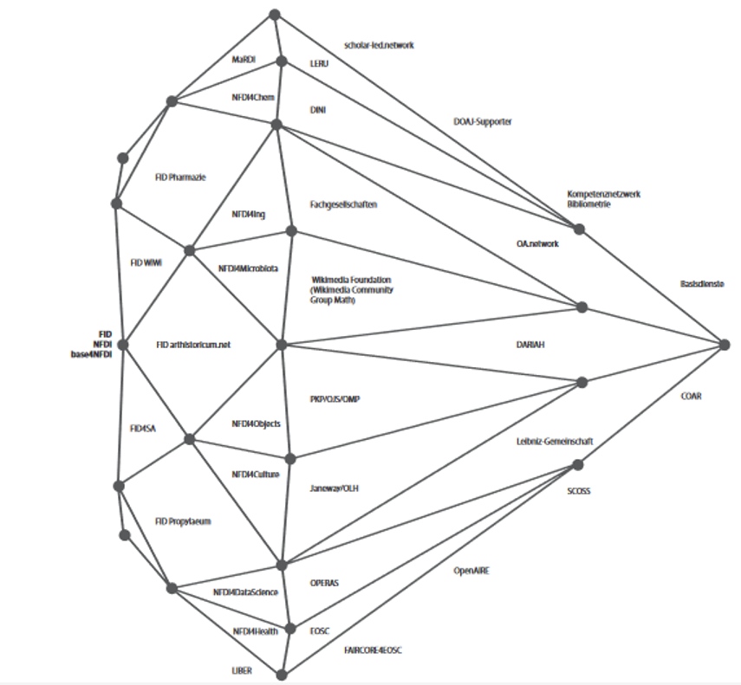
A Diamond and Its European Reflections:
The SeDOA Consortium for Diamond Open Access
11 September 2025
Dr. Michael Kaiser
(Max Weber Foundation)

Slide 2
Agenda
How it started
Introduction to DOA and SeDOA
How it’s going
SeDOA as a DOA matchmaker
What’s next?
Planned Services
Notes:
Interim status: OA Transformation gone astray?
New approaches: Diamond OA Infrastructures
Diamond Open Access Service Center (SeDOA)
Reliable Governance
Cooperative Infrastructures
Community expectations and engagement
Innovations for practice

Slide 3
What does SeDOA aim to achieve?
Develop a decentralised but networked German DOA infrastructure from a European perspective
Provide qualified publishing services and extensive support on multiple levels
Strengthen the quality and acceptance of institutional publishing
Address a wide range of disciplines (“one size does not fit all”)
Establish general standards and quality control mechanisms
Increase visibility and recognition of Diamond OA publications (registry)

Slide 4
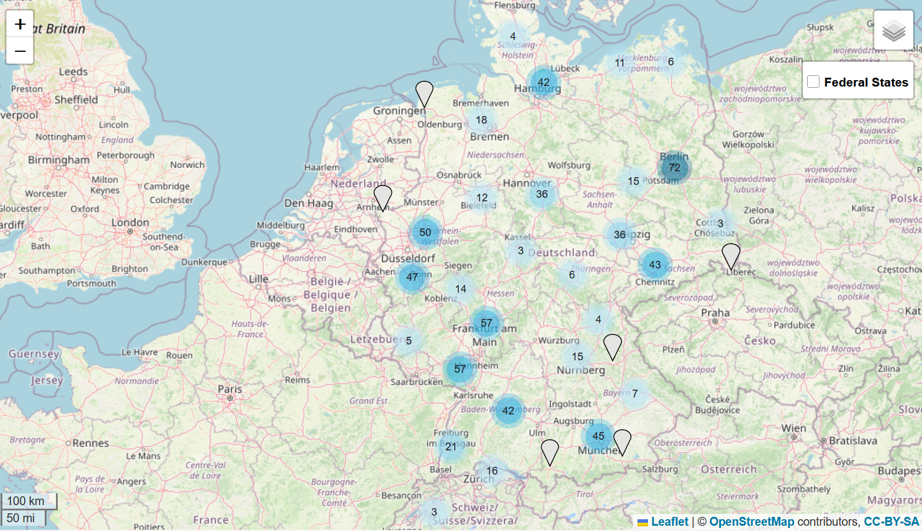
SeDOA in the German OA Landscape

Slide 5

SeDOA as an intermediary agency
in the European DOA Landscape
In the context of EDCH
national capacity center for Germany
Policy making
Aligning & coordinating activities
join task forces

Slide 6
SeDOA as a DOA matchmaker
SeDOA as a single point of contact will take care of:
integrating the German DOA landscape
facilitating: -cooperations
-innovation
-lessons learned / expertise, experience, training -community building
engagement
practice
Notes:
DFG erwähnen ?

Slide 7
Putting SeDOA to work, I
Appointing stakeholder & international advisory boards
List of events/presentations (12 completed or planned)
aside from conferences and presentations: training sessions, workshops
Running Survey
What kind of support and services does the DOA community need?

Slide 8
Putting SeDOA to work, II
Stakeholder map: chains of communication; connecting all stakeholders, communication concepts (disciplinary and regional level)
Who is our community? Who needs to be addressed?
State of Mecklenburg-Vorpommern is working on an OA strategy, we offer support
State of Lower Saxony is asking to become part of the European network, we help them to get in touch with the relevant players
Teaming up: Ongoing Meetings between Operas SIG Advocacy and SeDOA networking services
SeDOA as part of an international movement, eager to collaborate globally

Slide 9
Putting SeDOA to work, III
Practical criteria and clearing:
Which player, publication and business model fits into the international diamond standard? (broker role on the regional/national level for SeDOA)
LoI lead to the question: What is DOA?
Pragmatic definition of DOA needed

Slide 10
Putting SeDOA to work, IV
Cooperation with DOAJ and DOAB on practical criteria and challenges: shaping regional standards and aiming towards a common standard.
What are the day-to-day obstacles? e.g. licensing (CC BY vs. NC, ND)
State-of-the-art publication formats for Diamond OA: innovation on Diamond compatible and community owned formats & technology
cooperation between Operas Innovation Lab and SIL (SeDOA Innovation Lab)
ideathon for DOA innovation Berlin, 28 Nov 2025

Slide 11

Planned Services
Publication Services: Developing and operating a distribution hub as a central connector for Diamond OA publication services; aim: pooling of tailor made publishing capacities for customized academic journals, book series, living handbooks or publication projects with adequate discipline-specific DOA conditions
Community Support: Providing up-to-date information for capacity building such as Guidelines, checklists, best practices (organizational, technical, legal aspects)
Including research communities across all disciplines, local and national networks to facilitate stakeholder participation and contribute nationally to the global movement (adopt/adapt standards like DOAS)
Setting up the registry for DOA Journals: what criteria are to be applied?
Examples of “Bringing the service to individual scholars,
not the scholars to the service”
Notes:
Publishing Services
Expertise with different software solutions such as OJS, Janeway, MyCoRe
Services beyond existing ones, including printing, writing environments, editing software, metadata creation, PID assignment, hosting, etc.
Indexing in subject-specific and global databases (DOAJ, DOAB, WoS, Scopus, Dimensions, OpenAlex, etc.)
Long-term archiving with text and data mining options via project partners
Expand support with XML templates and training materials for publishing or flipping journals/books
Community Support
Additional interviews with DOA journal editors and scholarly societies
Provide up-to-date information for capacity building
Support for various publication formats
Reuse/adapt materials from other contexts (EU projects like DIAMAS, CRAFT-OA, PALOMERA)
Online/local workshops for training and networking
Build/coordinate an OJS network; focus on OJS training
Legal “advice” and expert reports
Networking Services
Establish SeDOA as the central hub for the Diamond movement in and for Germany
Connect Germany (DCC) and Europe (DCH)
Contribute to building a Global Diamond Open Access Alliance
Leverage projects like DIAMAS, CRAFT-OA, PALOMERA, and integrate results

Slide 12
Outreach
SeDOA is one piece of the global puzzle.
We are eager to align efforts, share knowledge, and build capacity together.
Together we can strengthen Diamond Open Access worldwide.
Let’s keep the conversation going!
Notes:
Folie eingefügt von RV

Slide 13
Thank you very much for your attention.
central contact: kontakt@diamond-open-access.de https://diamond-open-access.de/en/sedoa/
Notes:
MICHAEL

